Slide 1
Final Project
EEDG 6370
Mark Ivey
12/16/2024

Slide 2
Project Description
For this project, we were to take the sobel.c file and implement it in hardware on the Cyclone V.
We were to pass an image from the HPS to the FPGA, process the calculations there, and return the results for the HPS to reconstruct the filtered file.
We were to use the various tools at our disposal to synthesize the hardware and create the software.

Slide 3
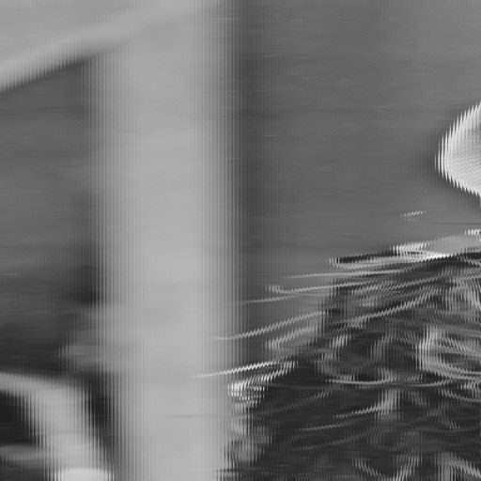
Results
I was unable to get the hardware to work completely.
  More specifically I do not believe my C code is properly configured to recover the data sent.
  Pictured is the output of a loopback test, passing though the FIFO’s.
  I was unable to get the filtering to work

Slide 4
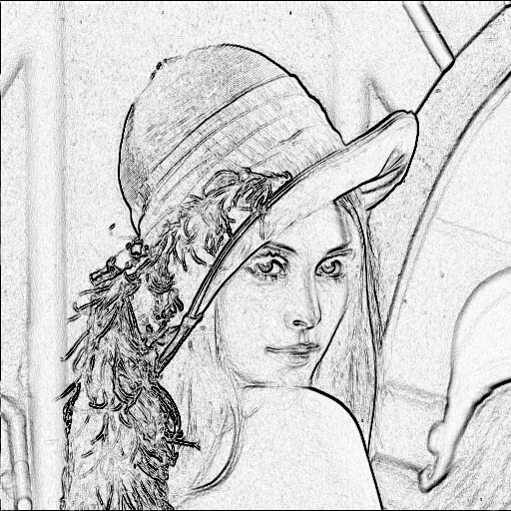
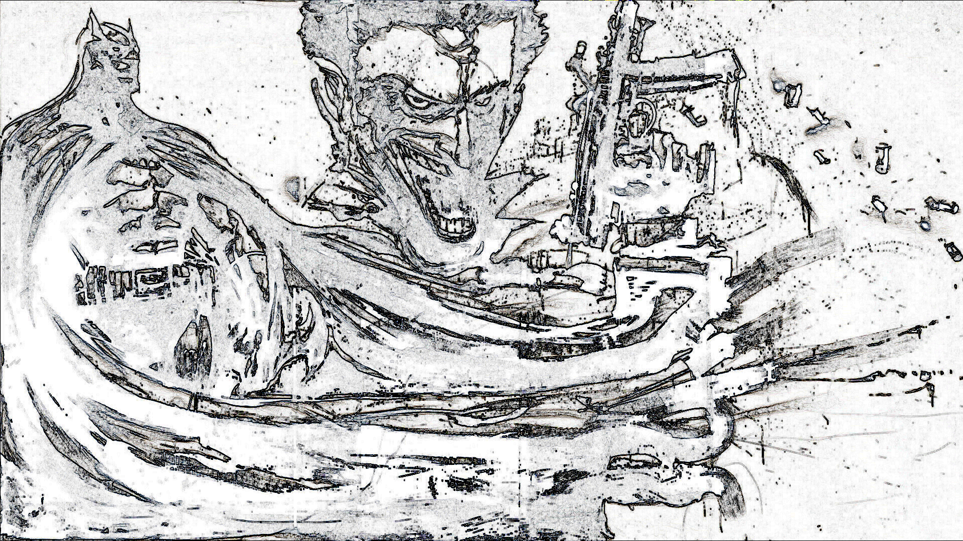
Software Filter
I was able to get the software to successfully convert the images, with the batman file taking 22.8 seconds, and the girl taking 0.33 seconds.

Slide 5
The Implementation
To implement the sobel in hardware, the plan was to use two FIFO’s to send and receive data from the FPGA fabric.
This proved very difficult as HAL files I initially planned to use were not completely available. The macros I found appear to work, but implementing them properly was a challenge.
Things I did not try were some of the other options in the next slide, and the use of CWB to try and speed up the software development.

Slide 6
Alternative Options I Did Not Explore
When thinking about implementing this project, I thought of a few ways that it could be done, of varying difficulty:
  GPIO pins to create a custom interface
  DMA
  Use of the SDRAM as a scratch area to process the image
  Edge detection IP

Slide 7

YouTube Video

